Slide 1
IMAGE PROCESSING
By
Viral 3

Slide 2
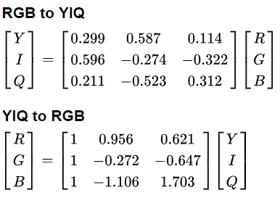
Some color spaces (channels)
The following represents a few popular channels/color spaces for an image: RGB, HSV, XYZ, YUV, YIQ, YPbPr, YCbCr, and YDbDr. We can use Affine mappings to go from one color space to another. The following matrix represents the linear mapping from the RGB to YIQ color space:

Slide 3
7-Converting from one color space into another
We can convert from one color space into another using library functions;
h (heu or color: dominant wave length of reflected light), s (saturation or chroma) and v (value or brightness)
***Providing the correct path to the images on the disk***

